Slide 1


Pre-Meeting To Do:
Sign up for CSA- fill out form
Sign up for Networking dinner
Stem Fair next Thursday: no Network Security

Slide 2
0xCryptography
Basic Ciphers and other Cryptography strategies found in CTFs

Slide 3


What is Cryptography
Cryptography is the practice and study of techniques for secure communication in the presence of third parties.
In CTF’s, the goal is to crack or clone objects or algorithms to reach the flag.

Slide 4
Common Cryptography methods:
Caeser Shift:
- When lettering and spaces look correct with the wrong letters
ROT1/ROT13 etc
- Similar to Caeser
Baconian
- Could be confused with binary (usually base 2 system)
Morse Code
- Dots n dashes
Vigenere
- If the above don’t work, Possible key is given

Slide 5
Common Encryption methods:
AES
RSA
N, E, C, Parts of the Encryption
Diffie-Hellmen
DES/3DES

Slide 6
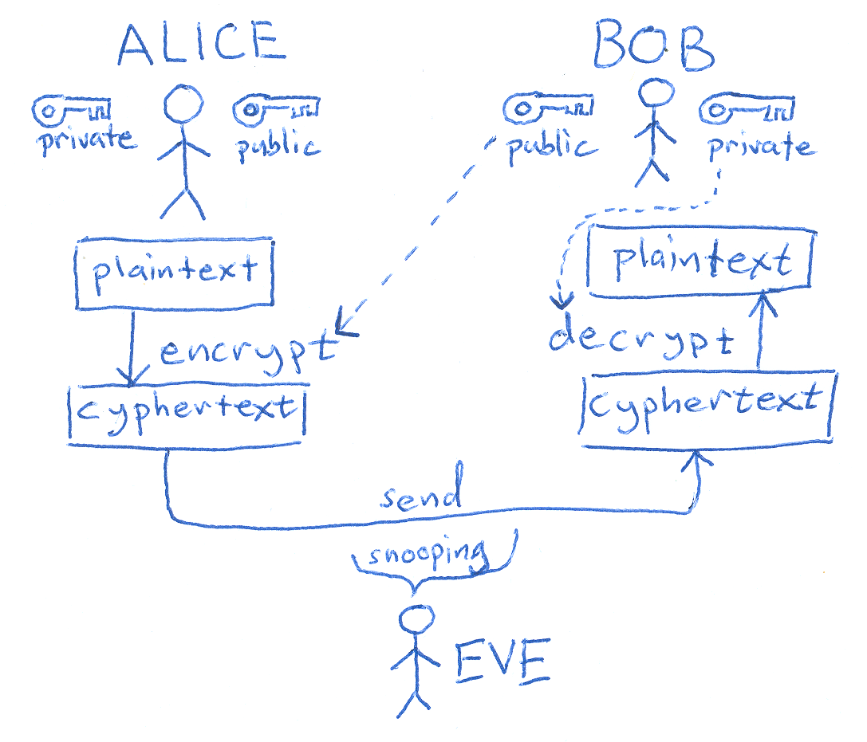
Cryptography in other ways:
Key Management
Understanding Asymmetric vs Symmetric
Certificate Authorities/Servers
XOR, other Bitwise manipulations
Related: Hashing Algorithms
Blockchain
Pictured is an Asymmetric Method

Slide 7
Key Vocabulary:
Ciphertext: encrypted text transformed from plaintext using an encryption algorithm
Plain text: Text that is readable, not specially formatted or written in code
Hash: Mathematical algorithm that maps data of an arbitrary size into a bit array of fixed size
Algorithm: Procedure that is carried out in sequential steps to solve a problem
Encryption: Process of converting information or data into a code
Salt: An arbitrary value added to a plaintext before hashing
Block Cipher: Data that is encrypted in chunks or blocks.

Slide 8
Strategies and Tools:
For basic Ciphers, the best strategy is recognizing ciphers
Algorithms & hashing problems:
Break down the source code, comment along each step
Lots of opensource tools and repos: check the next slide

Slide 9
DEMO:
Let’s work on CTFLearn, Crypto Challenges:
Character Encoding
Base 2 2 the 6
Morse Code
Vignere Cipher
BruXOR
Reverse Polarity
Hextraordinary

Slide 10
Example from Past CTF’s
https://github.com/JustinApplegate/thatsnotcrypto
https://0awawa0.medium.com/h-cktivitycon-2021-ctf-writeups-b93bc122fecd#06a5
https://0awawa0.medium.com/h-cktivitycon-2021-ctf-writeups-b93bc122fecd#8e18
https://anthares101.github.io/CTFs/H%40cktivityCon_2021/N1P/

Slide 11
Tools
https://www.dcode.fr/liste-outils#f0
https://github.com/7Hxz233/awesome-ctf-crypto
https://github.com/ashutosh1206/Crypton
https://ctfacademy.github.io/crypto/cyberchef.htm (my personal go to)
http://math.byu.edu/~doud/Vigenere/
https://github.com/Ganapati/RsaCtfTool
https://ctf101.org/cryptography/overview/ More Explanations Here
Other Challenges:
https://www.mysterytwisterc3.org/en/

